Slide 1
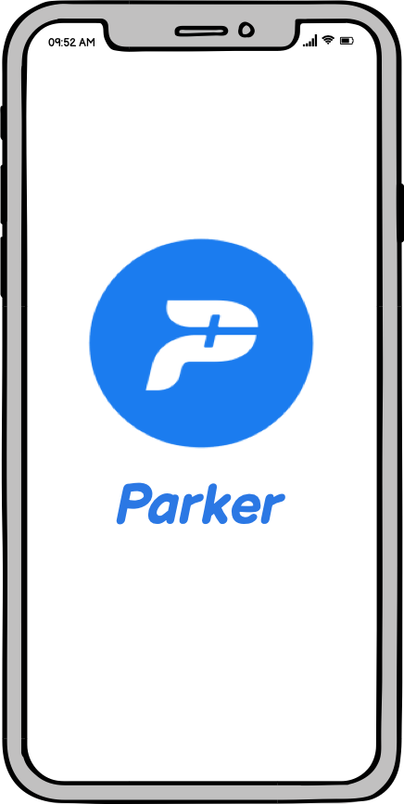
Subhadip Samanta
IIFT Delhi

Slide 2

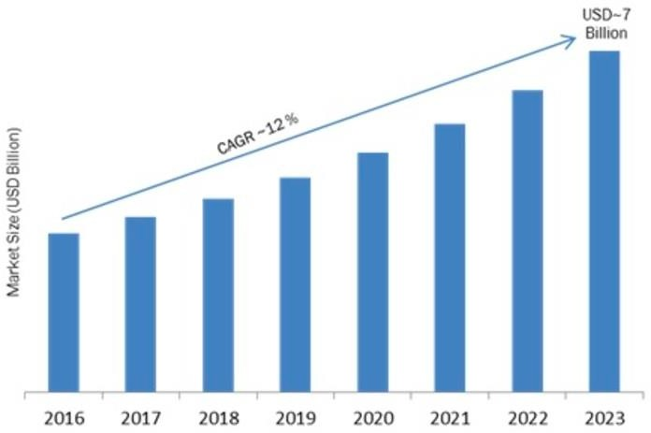
Parker
Parker is an application which helps people in finding empty available parking spaces in their vicinity.
Parking Industry Size in India
Their goal is to make parking easier and create tech- based solutions that power smart mobility and and make parking hassles of the past obsolete. This is done by connecting parking and mobility ecosystems, eliminating frequency while maximizing convenience and efficiency.
Competitor: GetMyParking, PparkE and ParkingRhino

Slide 3
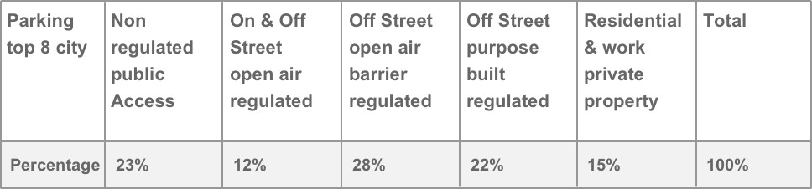
Expanding Market
The B2B market including top 8 cities in India is estimated to be INR 188K Cr (annually), while potential B2C market is estimated to be INR 30K Cr (annually) and it’s growing 30% YoY due to government policies to create more paid parking zones and include surge pricing.
If we look at the Frost & Sullivan Report of parking market size, Smart Parking market is anticipated to reach USD 100 Billion & growing at a CAGR of 18% from 2018 to 2023. The Asia Pacific and, by Geography and United States are expected to rise at a CAGR, respectively, throughout the forecast phase.
Types of Parking Spaces

Slide 4
Total Addressable Market
0-18 Years
(30%)
College Students (20%)
Urban (40%)
18-50 Years
(50%)
Use Public Transport (45%)
Working Class (80%)
Use Private Transport (55%)
Use Public Transport (30%)
Population
Working Class (60%)
Use Private Transport (70%)
50-70 Years
(20%)
Retired (40%)
Use Public Transport (35%)
Rural (60%)
Use Private Transport (65%)

Slide 5
Total Addressable Market
Calculation
Total Urban Population = 135 Cr * 0.4 = 54 Cr
18 – 50 Year Olds Population = 0.5 * 54 Cr = 27 Cr 70 % use a car/bike for transport = 0.7 * 27 Cr = 18.9 Cr Working Professionals using private transport = 0.20 * 0.55 * 18.9 Cr = 2.1 Cr
50 – 70 Year Olds Population = 0.2 * 54 Cr = 10.8 Cr 70 % use a car/bike for transport = 0.7 * 10.8 Cr = 7.56 Cr Working Professionals using private transport = 0.6 * 0.7 * 7.56 Cr = 3.2 Cr Retired Individuals using private transport = 0.4 * 0.65 * 7.56 Cr = 2.9 Cr
Market Size = 8.2 Cr
Assumptions
~40% Urban Population in India
Lesser Population in rural India owns a car, so not considered
70% of urban population
uses personal car or bike for
transportation for professional/leisure purpose.

Slide 6



User Persona
Utsav – Business Analyst
28 Year Old living in Mumbai
Spends his time by managing various activities in his personal and professional life
Often misses meetings
due to wandering for parking spaces, wants access to organised spaces
Avantika - Product Lead
35 Year Old living in Bangalore
Spends her time in completing tasks and meeting deadlines
Major part of her work is
to attend her clients in
offices. Bad traffic and unsafe place are her biggest struggles on the job
Lokesh - Retired Officer
55 Year old living in Kolkata
Spends his time with his family and keeping fit
He is concerned with the unnecessary loss of fuel resources and time
meandering for parking spaces and its impact on the future

Slide 7










Finding Early Adopters
Offering redeemable coupons and running commercials and advertisement on digital platform like Facebook, Instagram and LinkedIn can trigger the working class to download the app and test it for themselves
Trigger
Action
Target Audience
Capital Intensive
First 500 Sign-Ups
Banners and Advertisements at bus stands/metro and other public places having interactive posters with QR codes
10,000 Sign-Ups
2000 Sign-Ups
Referral
Rewards
Retention
Leveraging pool of repeat/passive customers by lucrative offers through referral program: Inactive user > Offer (Trigger) > Referral > New Users
Offering users bulk discounts on weekly/month-long pass/year-long pass
Converting one time users to repeat customers: Push Notifications > Offers & Discounts

Slide 8
MVP Features
This product will be used by users from varied demographics like age, education level, job status. The following are the features:
Account Creation Login through email address or phone number
Adding details to the profile by providing general data and information about the vehicle they own
Searching any vehicle's information (chassis number, engine number and date insured upto) through its number plate
Booking a parking spot for a short duration of time (few hours) or renting it for a longer timeframe (few months)
Viewing the details of present and previous bookings and transactions
Searching, viewing and paying E-Speeding tickets and other fines
Buying automobile insurance at a lower price than the general market
Finding nearby Pollution Under Control Certification (PUCC) centre and RTO stations

Slide 9
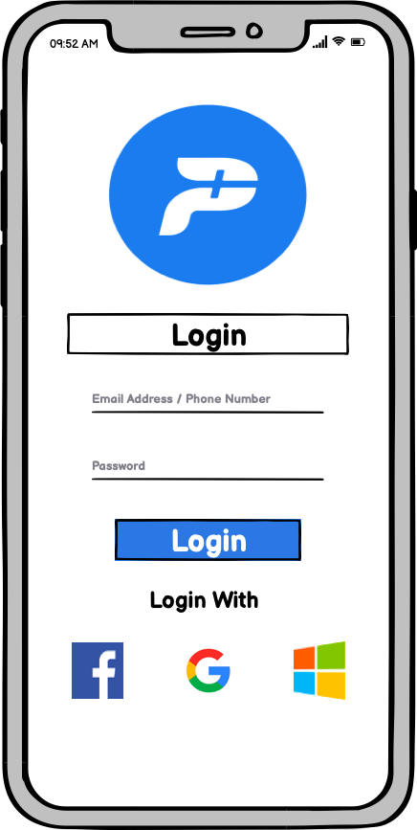
Wireframes
The user can sign-up/login through their -
Email Address
Phone Number
Alternate Ways of signing-up and logging-in are -
Facebook
Google
Microsoft

Slide 10
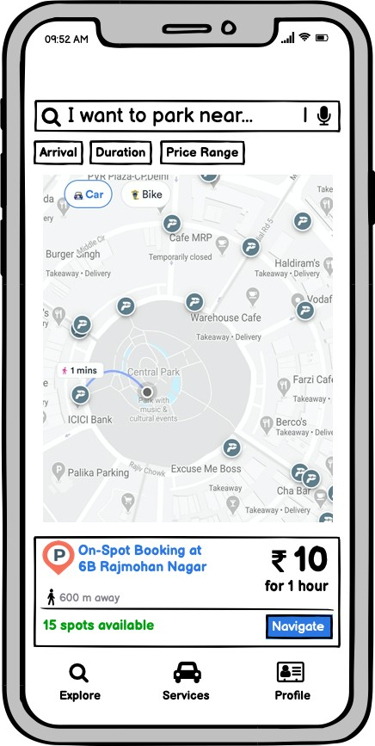
Wireframes
User can type the destination they want to park near or use voice commands
The parking spots are filtered on the basis of -
Arrival
Duration
Price Range
There are separate parking sections for car and bikes Indicator for -
Distance of the spot from the user’s current location
Number of Spots available

Slide 11
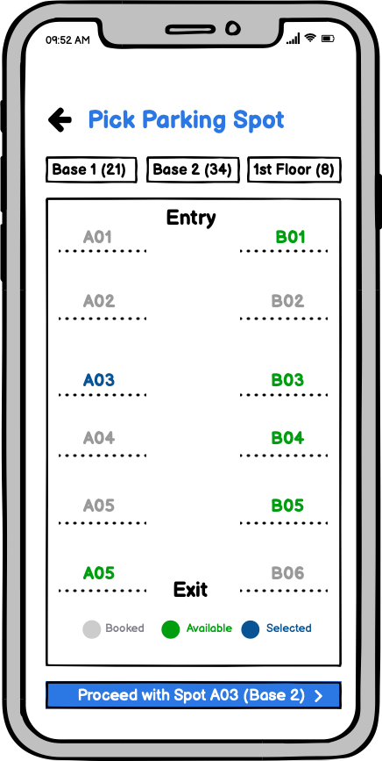
Wireframes
For an any particular parking location, the following are shown –
Levels of Parking
Layout of the Parking Lot
Booked, available and selected parking spots
User for can pay for their spot ahead of-time or after their duration is over through –
Cash/Credit
Online Wallets
Vouchers

Slide 12
Monetization Model
Parker - "Freemium" business model, most of the app and it's features are available free of charge to all users, with value-added premium products available to paying customers.
Most of Parker's revenue will be generated from the following streams:
Charging Commission
B2C
55% of total revenue will come from charging a certain % of commission from the user on the payment they make for the occupied parking space. There will amount will be surge pricing during peak office hours, when demands increase
B2B
20% of total revenue will come from taking a percentage from the insurance corporations onboarded for the brand, if the user buys an insurance through the Parker platform

Slide 13
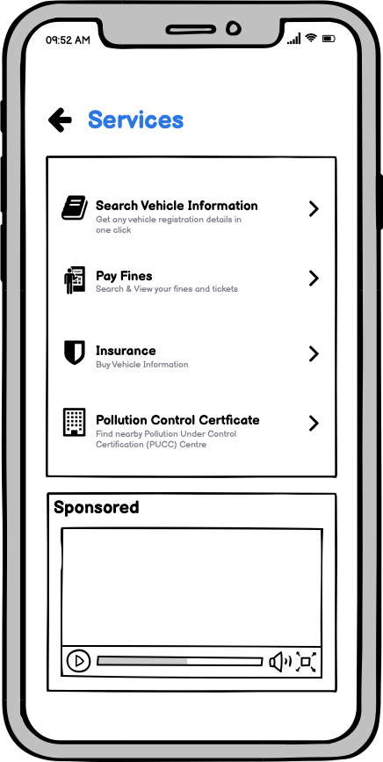
Monetization Model
Marketing Solution
Marketing Solutions provides a platform for companies to advertise to IndiaHikes users, it will account for 15% of total revenue, from a combination of advertising sold to online marketers and the sales of 'sponsored updates’
Revenue by displaying ads on banners - 305x165 and 250x150 on the app
Premium Subscription
The remaining 10% of revenue will be coming from premium subscriptions. The subscription will give the user access to a weekly/monthly pass (with a credit limit). The fares for the users won't be affected (increased) during surge pricing

Slide 14
Important Metrics
Acquisition
Number of Sign-Ups
Weekly growth in App downloads
Retention and Engagement
Customer Churn Rate
Stickiness (DAU/MAU)
Average Session Duration
% change in NPS
Revenue
% change in ARPU
% change in user base upgrading to a paid subscription model.

